Slide 1




Basic Web Design
CSS
LECTURE - 09

Slide 2
Recap
CSS Box Model
CSS Borders
CSS Margins
CSS Padding
CSS Height, Width and Max-width
CSS Outline

Slide 3
Course Contents
CSS Text, Font, Font Family
CSS List
CSS Table
Design Practice

Slide 4
CSS Text
Property | Examples
Text color | color:green;
Text alignment | text-align:center; [left, right, justify]
Text decoration | text-decoration: none; [underline, overline, line-through]
Text transformation | text-transform:uppercase; [lowercase, capitilize]
Letter spacing | letter-spacing:2px;
Line height | line-height:1.5;
Text indent | text-indent:30px;
Word spacing | word-spacing:5px;
Text shadow | text-shadow: 2px 2px 2px gray; [horizontal, vertical, blur]

Slide 5
CSS Text Example
h1 {
color: #4CAF50;
text-align: center;
text-transform: uppercase;
letter-spacing: 3px;
font-size: 30px;
text-shadow: 1px 1px 2px black;
}

Slide 6
CSS Font
Property | Examples
Font size | Font-size:12px;
Font weight | Font-weight: bold; [normal, lighter, bolder] and Numeric: 100 to 900
Font style | font-style: italic; [normal, oblique]
Font Family | Font-family:"Arial", "Helvetica", sans-serif;

Slide 7
CSS Font Family
Generic Font Family | Examples of Font Names
Serif | Times New Roman ,Georgia , Garamond
Sans-serif | Arial, Verdana, Helvetica
Monospace | Courier New, Lucida Console, Monaco
Cursive | Brush Script MT Lucida Handwriting
Fantasy | Copperplate Papyrus

Slide 8
CSS Font Example
body {
font-family: "Verdana", sans-serif;
font-size: 14px;
font-weight: 400;
font-style: normal;
line-height: 1.6;
letter-spacing: 1px;
word-spacing: 2px;
}

Slide 9
CSS List
Property | Examples
Unordered List | List-style-type : none; [square, disc, circle]
Ordered List | List-style-type : decimal; [upper-roman, lower-roman, upper-alpha, lower-alpha, none]
Style Position | list-style-position: inside; [outside]
Style Image | list-style-image: url('image.png');
Padding, margin

Slide 10
CSS Table
table {
font-family: Arial, Helvetica, sans-serif; border-collapse: collapse; width: 100%;
}
td, th {
border: 1px solid #ddd; padding: 8px;
}
table tr:nth-child(even){background-color: #f2f2f2;}
table tr:hover {background-color: #ddd;}
table th {
padding-top: 12px; padding-bottom: 12px; text-align: left; background-color: #04AA6D; color: white;
}

Slide 11
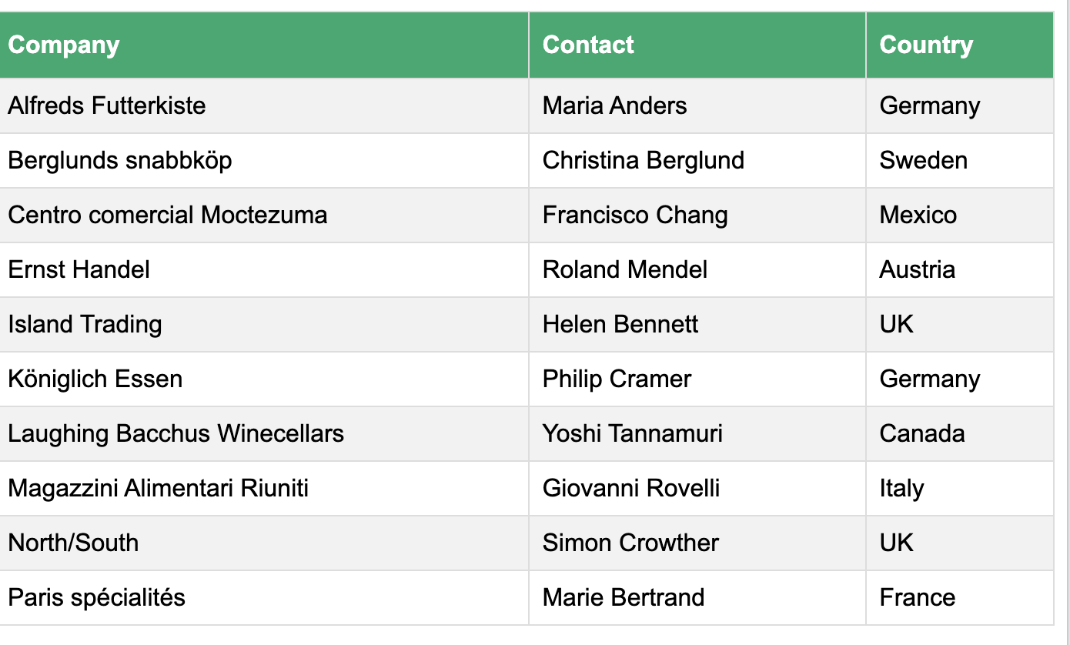

Slide 12
Exercise
Design the website you have created during quiz exam 1 using CSS.
- Add header and footer with background and text color
-Customize the List in the first page using CSS
- Design the table in the second page - In the third page, add a div and set background color, and box model property for this this

Slide 13

End of Lecture​

